Slide 1
QUIZ APPLICATION
Semester Long Project

Slide 2
Table of Content
1 Login Class
2 Register Class
3 Credentials Class
4 Rules and Score Class
5 Quiz Class
6 Main Methods

Slide 3
Agenda
User Registration
Rules
Question Display
Answer Submission
Scoring
Results
Timer

Slide 4
OOPS Concepts
Classes and Objects
Class in Java is a template or a blueprint for creating Objects, and it defines the attributes and behaviors of Objects of a certain type. On the other hand, an Object is an Instance of a Class, representing a real-world entity with its behavior and state.
Register Class:
Represents the registration form of the quiz application.
Inherits from the JFrame class.
Constructs a registration form with input fields for username and password.
Displays error messages for incomplete or invalid inputs.
Provides an option to navigate back to the login page if the user is already registered.

Slide 5
Rules and Score Class:
Displays the rules of the quiz game.
Inherits from the JFframe class and implements the ActionListener interface.
Represents the score page displayed after completing the quiz.
Provides options to play again or close the application.
Credentials Class:
Manages user credentials for login functionality.
Provides methods to add and validate users’ credentials.
Utilizes exceptions for error handling, including FileDeletedException, UserAlreadyExistsException and UserDoesNotExistsException.
Login Class:
Represents the login page of the quiz application.
Inherits from the JFrame class and implements the ActionListener interface.

Slide 6
Quiz Class:
Implements the quiz functionality.
Displays questions with multiple-choice options.
Tracks user answers and calculates scores.
Includes a timer for each question.
Main Methods:
. Both Login and Quiz classes have a main method to instantiate objects of their respective classes.

Slide 7
Encapsulation
Access Modifiers:
The access modifiers private and static are used to encapsulate variables and methods within the Credentials class. For example, the path, fileName, and name variables are declared as private static, restricting direct access from outside the class and ensuring data encapsulation.
Encapsulation of Data:
The Credentials class encapsulates data related to user credentials management, including username, password, and file paths. These details are hidden from other classes and are accessed only through well-defined methods like addUser(), validate() etc.
Exception Handling:
Custom exception classes (FileDeletedException, UserAlreadyExistsException and UserDoesNotExistsException) are encapsulated within the Credentials class. These exceptions encapsulate specific error conditions and provide controlled access to exception handling logic.

Slide 8
Method Encapsulation:
The addUser() and validate() methods encapsulate the logic for adding a new user and validating user credentials, respectively. These methods encapsulate the implementation details of user management and provide a clear interface for interaction with other parts of the program.
Grouping Related Functionality:
Related functionality, such as user registration and login, is encapsulated within the Login and Register classes, respectively. This encapsulation helps in organizing and managing different aspects of the application's behavior in a modular and understandable way.
Encapsulation of Data and Logic:
The Register, Rules, and Score classes encapsulate specific functionality related to registration, displaying rules, and showing the score, respectively. Each class encapsulates its own set of UI components and logic.
Overall, encapsulation helps in organizing the code into modular, self-contained units, improving code readability, maintainability, and reusability. It also promotes the principle of separation of concerns, where each class is responsible for a specific aspect of the application'functionality.

Slide 9
Inheritance
Inheritance is a fundamental concept in object-oriented programming (OOP) where a class (subclass or derived class) can inherit properties and behaviour (methods) from another class (superclass or base class). This allows the subclass to reuse existing code from the superclass and extend its functionality. Following are the uses of Inheritance in our project:.
Login, Quiz, Register, and Score classes extend Jframe.
Inherits all properties and methods of JFrame.
Utilizes JFrame functionality for window creation and management.
Utilizes inherited methods to integrate Swing components (e.g., JLabel, JButton etc.) into the window.
Properties and position components within the window can be set using inherited methods.
Utilizes inherited methods to respond to user actions.

Slide 10
Polymorphism
Polymorphism is a fundamental concept in object-oriented programming (OOP) that allows objects of different classes to be treated as objects of a common superclass. It enables a single interface to represent multiple underlying forms (classes) and allows objects to be processed uniformly regardless of their specific types.
Method Overriding:
Custom exception classes (e.g. FileDeletedException, UserAlreadyExistsException override the toString() method to provide meaningful error messages.
The actionPerformed() method is overridden in various classes (e.g., Login, Quiz, Register, Rules, Score) to define specific actions for button clicks.
Interface Implementation:
Classes such as Login, Quiz, Register, Rules and Score implement the ActionListener interface to handle action events like button clicks.
By implementing this interface, these classes define the actionPerformed() method to respond to user interactions uniformly.

Slide 11

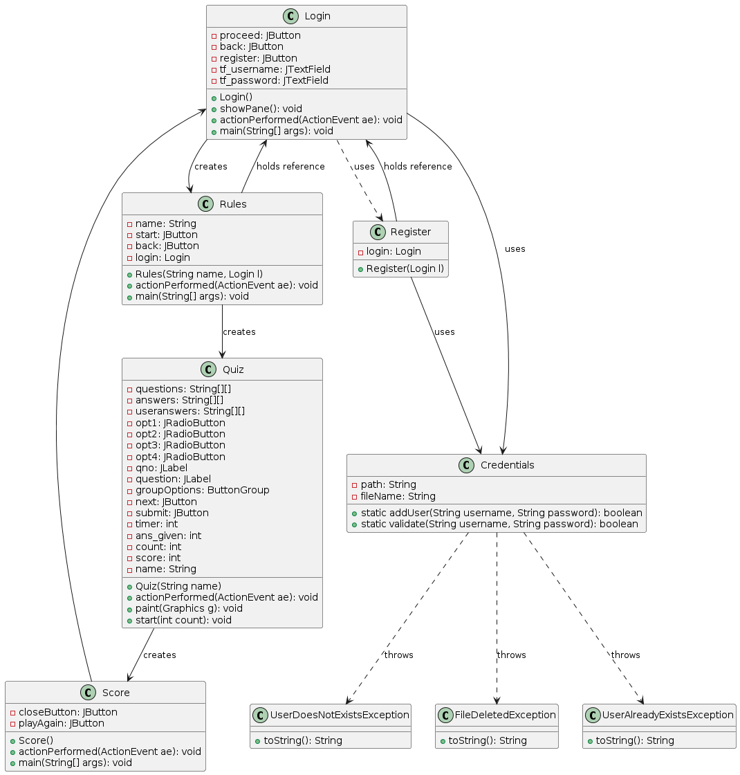
UML Of Quiz Application

Slide 12
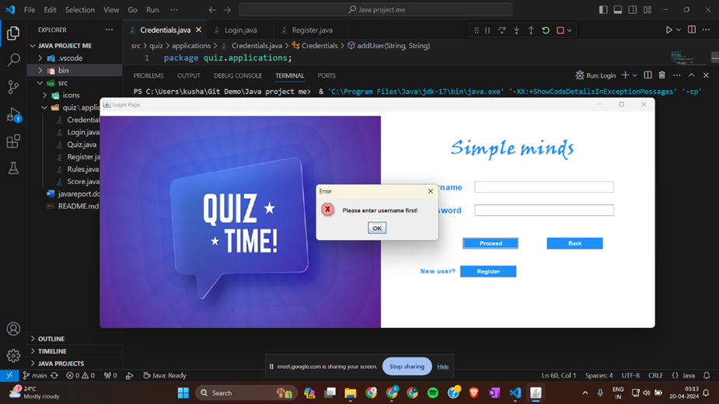
Code implementation:
Login Page
1) If username not entered

Slide 13

2) Missing password

Slide 14
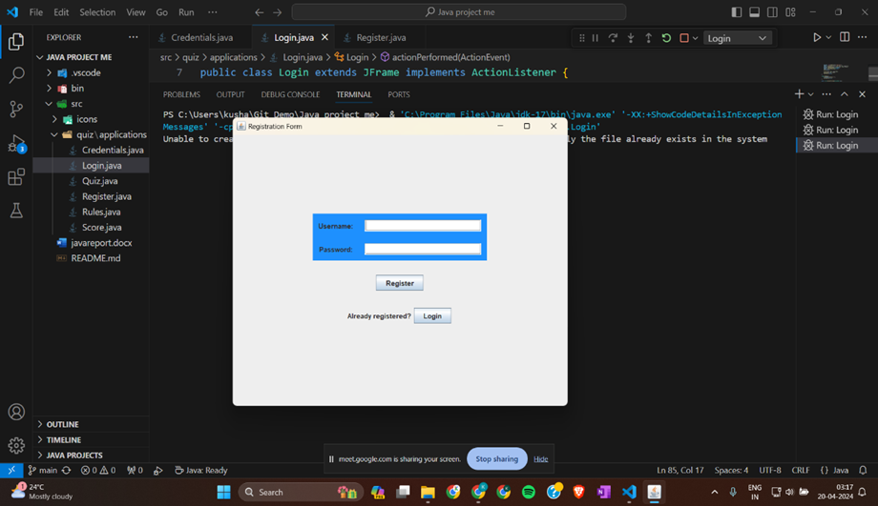
3) Register?

Slide 15
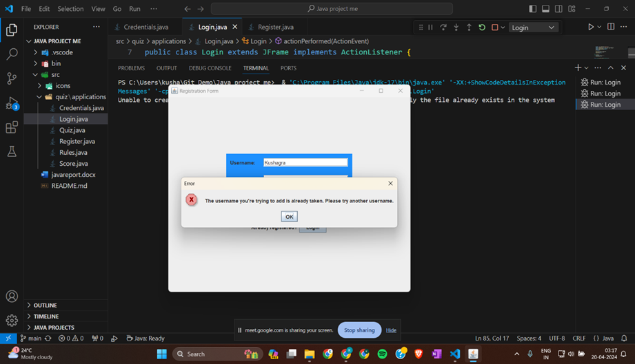
4) If user already registered.

Slide 16
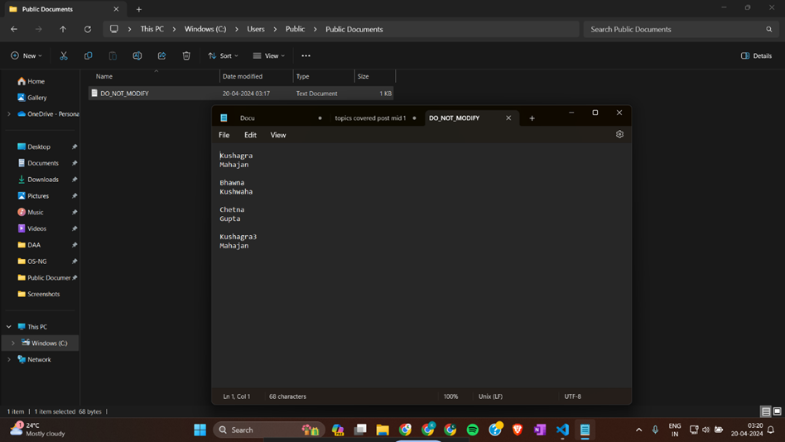
5) Data stored in text file.

Slide 17
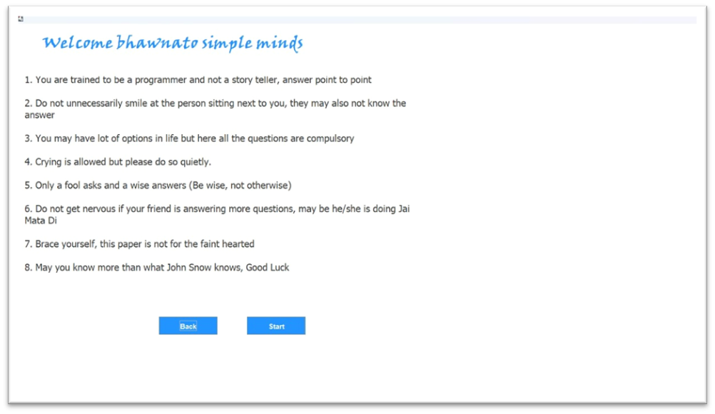
Rules Page

Slide 18
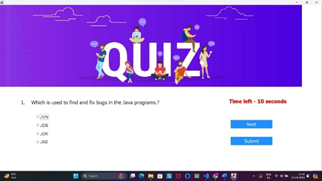
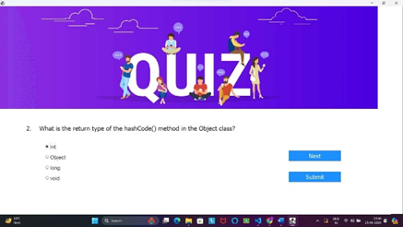

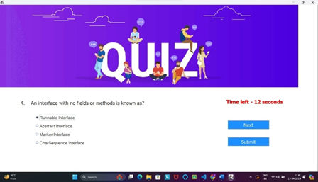
Questions

Slide 19
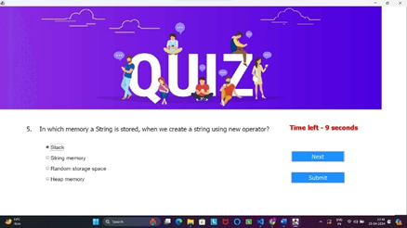


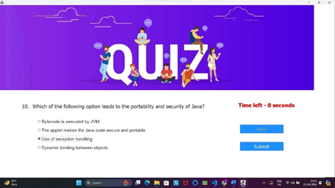

Slide 20
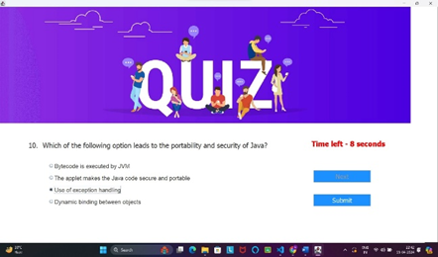
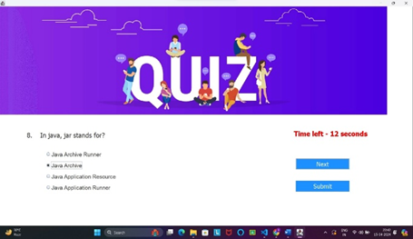

Slide 21
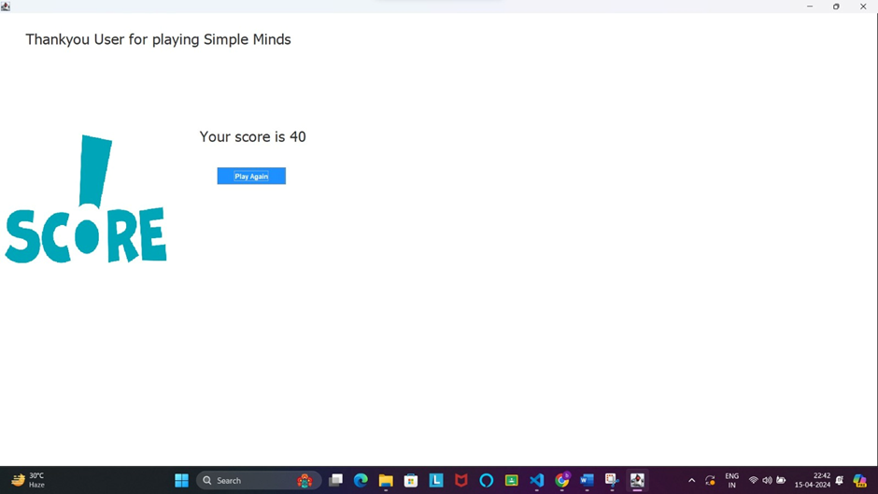
Score

Slide 22
Conclusion
The creation of the "Simple Minds" quiz app highlights our team's collaborative efforts in utilizing Java programming and GUI design to craft an engaging application. Working together, we effectively implemented various features and functionalities, ensuring the app meets its primary goals. However, we recognize that teamwork doesn't end with the current version. As a team, we're committed to continuous improvement, embracing feedback, and leveraging each other's strengths to refine the application further. This collaborative spirit sets the groundwork for future enhancements, where our collective skills and dedication will drive the app's evolution to better serve our users and adapt to technological advancements.

Slide 23
Thank You!

